Slide 1
ER diagram practice

Slide 2
Activity 1:
Draw an entity relationship diagram for the given senario. Mention keys, cardinality ratios and participation with proper notation. State assumption if any.
Please note that after solving this activity there is going to be a class participation activity. Please pay attention and solve this activity with me step by step for good practice .

Slide 3
Departmental store database
A store wants to keep track of all its musical albums.
Musical album have a title, price , a unique identifier as albumId
There are artists who create albums. We save artists name and CNIC for our record.
One artist can create multiple albums. But one album can only belong to a single artist.
One album can be of a single genre.
Genre has genereID , name, description.
Multiple albums can have a same genre.

Slide 4
Step 1: find all entities and their attributes.
Musical album have a title, price , a unique identifier as albumId There are artists who create albums. We save artists name and CNIC for our record. One artist can create multiple albums. But one album can only belong to a single artist. One album can be of a single genre. Genre has genereID , name, description. Multiple albums can have a same genre.

Slide 5
Step 1: find all entities and their attributes.
Musical album have a title, price , a unique identifier as albumId There are artists who create albums. We save artists name and CNIC for our record. One artist can create multiple albums. But one album can only belong to a single artist. One album can be of a single genre. Genre has genereID , name, description. Multiple albums can have a same genre.
Title
Album
albumid
Price

Slide 6
Step 1: find all entities and their attributes.
Musical album have a title, price , a unique identifier as albumId There are artists who create albums. We save artists name and CNIC for our record. One artist can create multiple albums. But one album can only belong to a single artist. One album can be of a single genre. Genre has genereID , name, description. Multiple albums can have a same genre.

Slide 7
Step 1: find all entities and their attributes.
Musical album have a title, price , a unique identifier as albumId There are artists who create albums. We save artists name and CNIC for our record. One artist can create multiple albums. But one album can only belong to a single artist. One album can be of a single genre. Genre has genereID , name, description. Multiple albums can have a same genre.
Name
Title
Album
Artists
albumid
CNIC
Price

Slide 8
Step 2: find all entities and their attributes. + relationship
Musical album have a title, price , a unique identifier as albumId There are artists who create albums. We save artists name and CNIC for our record. One artist can create multiple albums. But one album can only belong to a single artist. One album can be of a single genre. Genre has genereID , name, description. Multiple albums can have a same genre.
Name
Title
Creates
Album
Artists
albumid
CNIC
Price

Slide 9
Step 2: find all entities and their attributes. + relationship
Musical album have a title, price , a unique identifier as albumId There are artists who create albums. We save artists name and CNIC for our record. One artist can create multiple albums. But one album can only belong to a single artist. One album can be of a single genre. Genre has genereID , name, description. Multiple albums can have a same genre.
Name
Title
Creates
Album
Artists
albumid
CNIC
Price

Slide 10
Step 2: find all entities and their attributes. + relationship
Musical album have a title, price , a unique identifier as albumId There are artists who create albums. We save artists name and CNIC for our record. One artist can create multiple albums. But one album can only belong to a single artist. One album can be of a single genre. Genre has genereID , name, description. Multiple albums can have a same genre.
Name
Title
M
1
Creates
Album
Artists
albumid
CNIC
Price

Slide 11
Step 2: find all entities and their attributes. + Relationship
Musical album have a title, price , a unique identifier as albumId There are artists who create albums. We save artists name and CNIC for our record. One artist can create multiple albums. But one album can only belong to a single artist. One album can be of a single genre. Genre has genereID , name, description. Multiple albums can have a same genre.
Name
Title
M
1
Creates
Album
Artists
albumid
CNIC
Price

Slide 12
Step 2: find all entities and their attributes. + relationship
Musical album have a title, price , a unique identifier as albumId There are artists who create albums. We save artists name and CNIC for our record. One artist can create multiple albums. But one album can only belong to a single artist. One album can be of a single genre. Genre has genereID , name, description. Multiple albums can have a same genre.
albumid
Name
Title
M
1
Creates
Price
Album
Artists
M
Has
CNIC
genreid
1
Genre
name
description

Slide 13
Step 3: find all entities and their attributes. + relationship + participation
Musical album have a title, price , a unique identifier as albumId There are artists who create albums. We save artists name and CNIC for our record. One artist can create multiple albums. But one album can only belong to a single artist. One album can be of a single genre. Genre has genereID , name, description. Multiple albums can have a same genre. Assumption1 : album cannot be created without artist. But artist can exist without launching an album. Assumption 2: album will have genre but there is possibility that genre exists but there is not album on that genre.
albumid
Name
Title
M
1
Creates
Price
Album
Artists
M
Has
CNIC
genreid
1
Genre
name
description

Slide 14
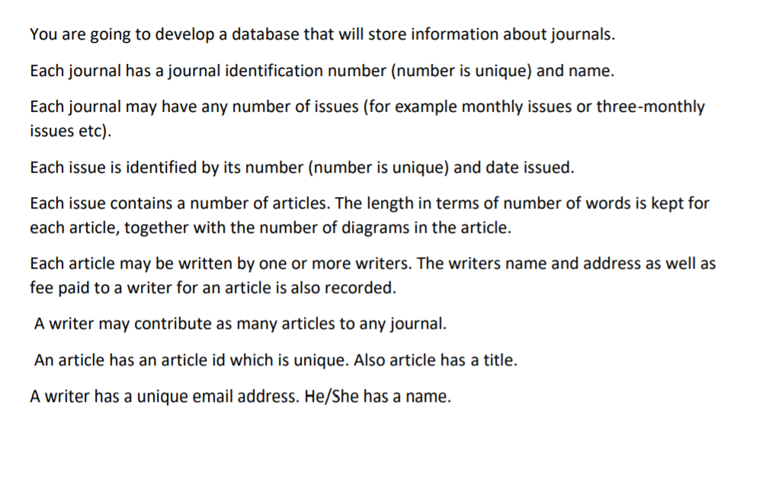
Activity # 2

Slide 15
Activity # 2

Slide 16
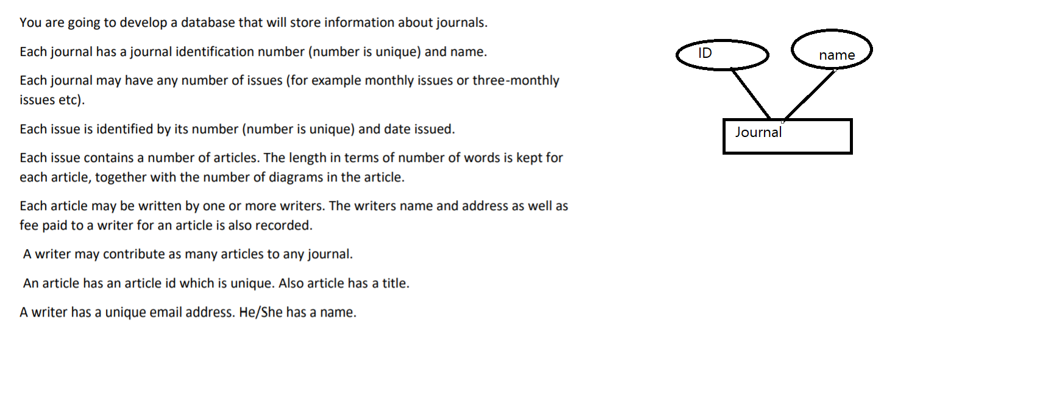

Slide 17
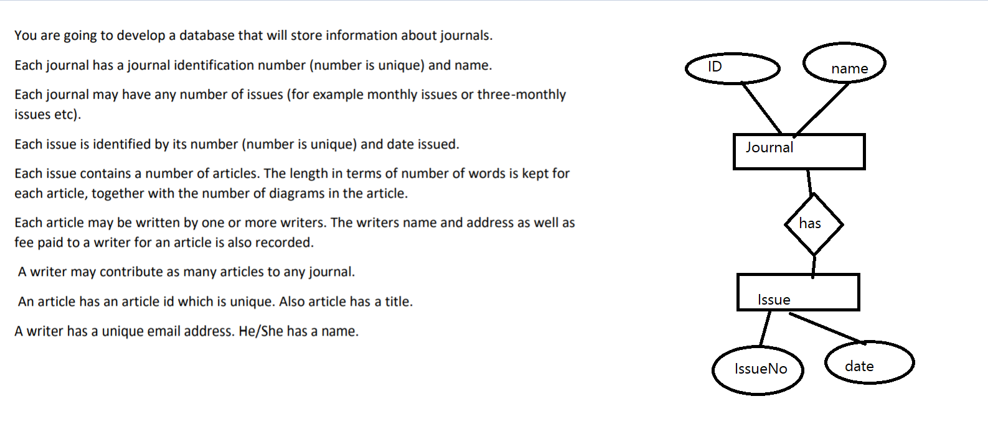

Slide 18
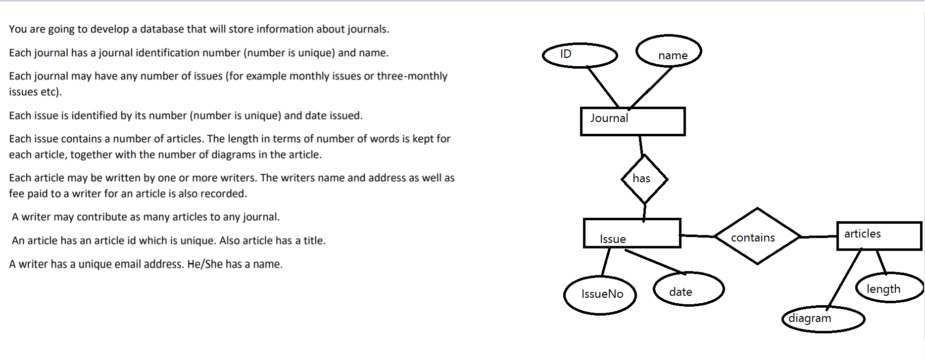

Slide 19
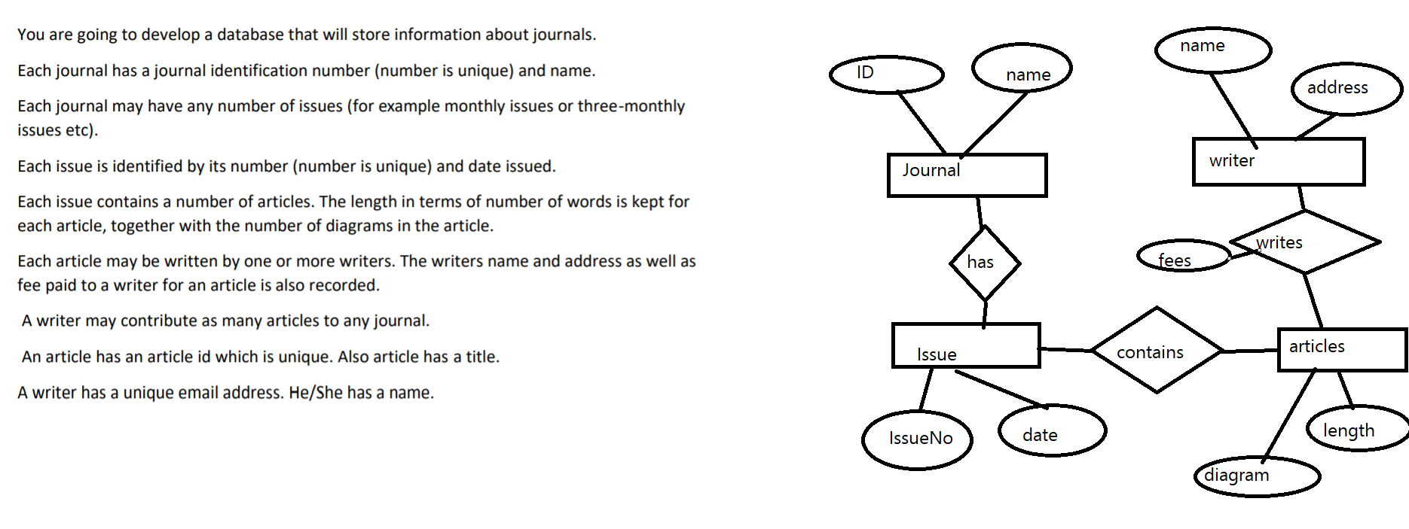

Slide 20
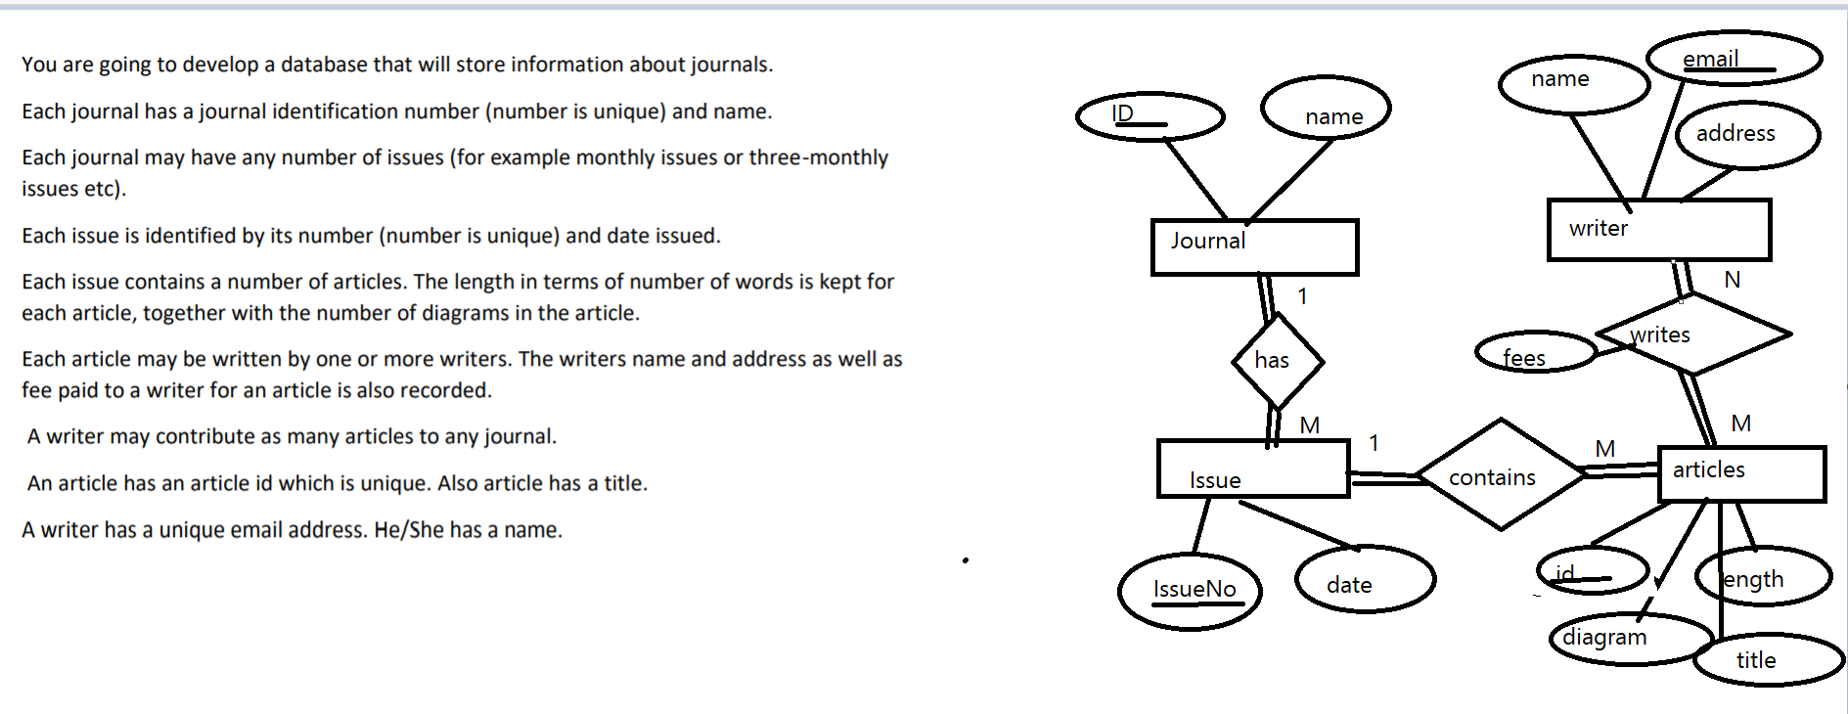

Slide 21
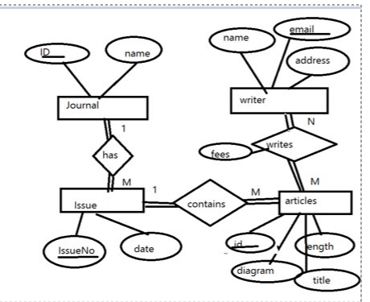

Slide 22
Activity # 2
Draw an entity relationship diagram for the given senario. Mention keys, cardinality ratios and participation with proper notation. State assumption if any.
. Consider a MOVIEdatabase in which data is recorded about the movie industry.The data requirements are summarized as follows:
Each movie is identified by title and year of release. Each movie has a length in minutes. Each has a production company, and each is classified under one or more genres (such as horror, action, drama, and so forth). Each movie has one or more directors and one or more actors appear in it.Each movie also has a plot outline.Finally,each movie has zero or more quotable quotes, each of which is spoken by a particular actor appearing in the movie.
Actors are identified by name and date of birth and appear in one or more movies.Each actor has a role in the movie.
Directors are also identified by name and date of birth and direct one or more movies.It is possible for a director to act in a movie (including one that he or she may also direct).
Production companies are identified by name and each has an address.A production company produces one or more movies.

Slide 23
Activity # 3 Company database
The company is organized into departments. Each department has a unique name, a unique number, and a particular employee who manages the department. We keep track of the start date when that employee began managing the department. A department may have several locations.
A department controls a number of projects, each of which has a unique name, a unique number, and a single location.
We store each employee’s name, Social Security number,2 address, salary, gender , and birth date. An employee is assigned to one department, but may work on several projects, which are not necessarily controlled by the same department. We keep track of the current number of hours per week that an employee works on each project. We also keep track of the direct supervisor of each employee (who is another employee).
We want to keep track of the dependents of each employee for insurance purposes. We keep each dependent’s first name, gender, birth date, and relationship to the employee. We only need the data of dependent till employee will work for us.

Slide 24
